Slide 1
1 Corinthians 1:17-31

Slide 2
¹⁷ For Christ did not send me to baptize but to preach the gospel, and not with words of eloquent wisdom, lest the cross of Christ be emptied of its power.
¹⁸ For the word of the cross is folly to those who are perishing, but to us who are being saved it is the power of God. ¹⁹ For it is written,
“I will destroy the wisdom of the wise,
and the discernment of the discerning I will thwart.”

Slide 3
²⁰ Where is the one who is wise? Where is the scribe? Where is the debater of this age? Has not God made foolish the wisdom of the world? ²¹ For since, in the wisdom of God, the world did not know God through wisdom, it pleased God through the folly of what we preach to save those who believe. ²² For Jews demand signs and Greeks seek wisdom, ²³ but we preach Christ crucified, a stumbling block to Jews and folly to Gentiles, ²⁴ but to those who are called, both Jews and Greeks, Christ the power of God and the wisdom of God. ²⁵ For the foolishness of God is wiser than men, and the weakness of God is stronger than men.

Slide 4
²⁶ For consider your calling, brothers: not many of you were wise according to worldly standards, not many were powerful, not many were of noble birth. ²⁷ But God chose what is foolish in the world to shame the wise; God chose what is weak in the world to shame the strong; ²⁸ God chose what is low and despised in the world, even things that are not, to bring to nothing things that are, ²⁹ so that no human being might boast in the presence of God.

Slide 5
³⁰ And because of him you are in Christ Jesus, who became to us wisdom from God, righteousness and sanctification and redemption, ³¹ so that, as it is written, “Let the one who boasts, boast in the Lord.”

Slide 6
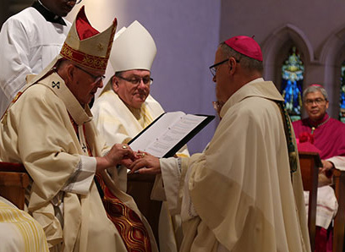
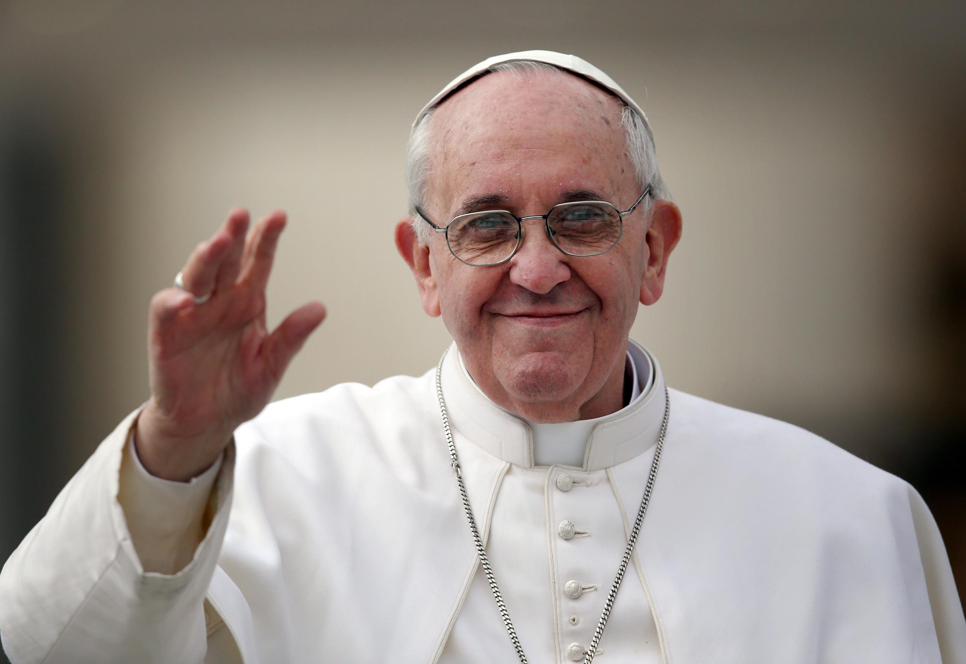
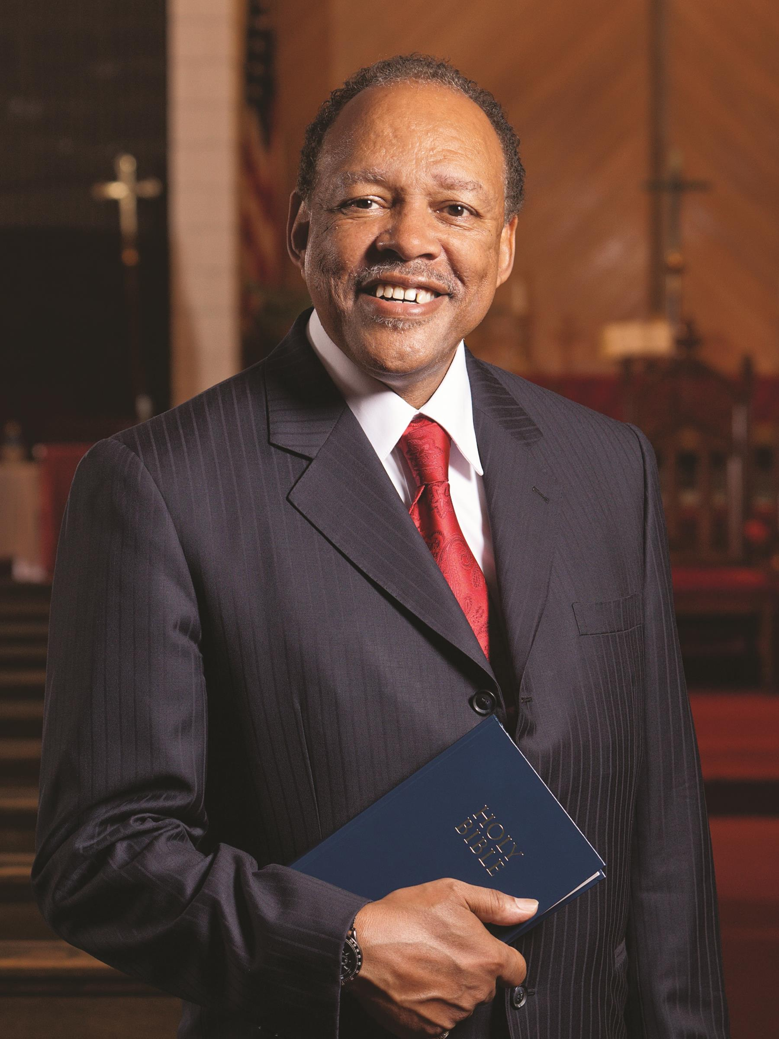
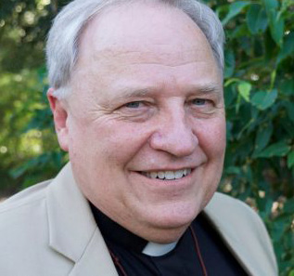
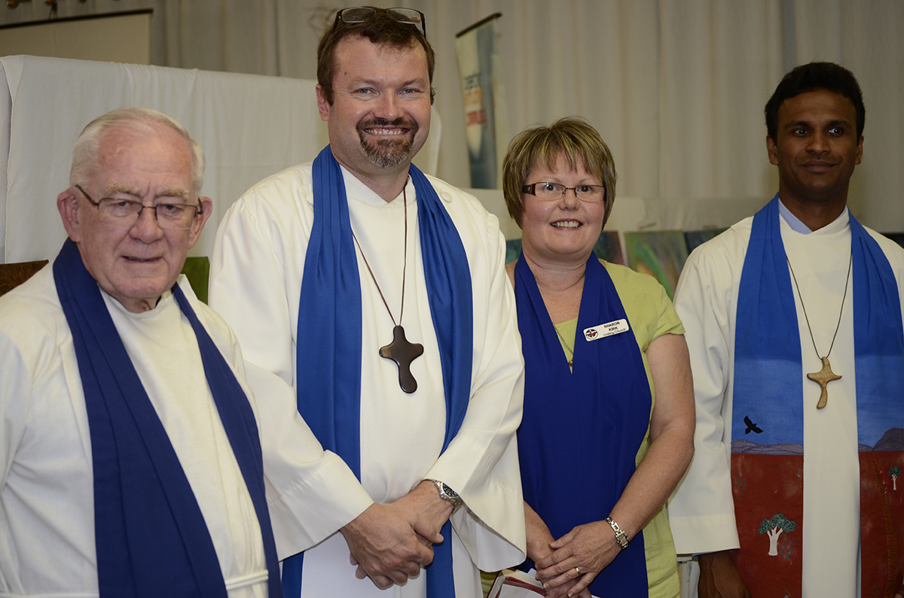
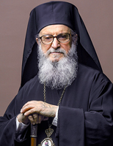

Slide 7
If you can’t handle being thought of as “a fool”,
you can’t handle being a Christian in Australia today
The word of the cross is folly to those who are perishing, but to us who are being saved, it is the power of God
Prominent academics become celebrities as they criticise Christianity

Slide 8
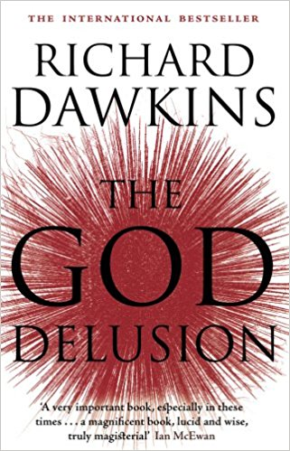
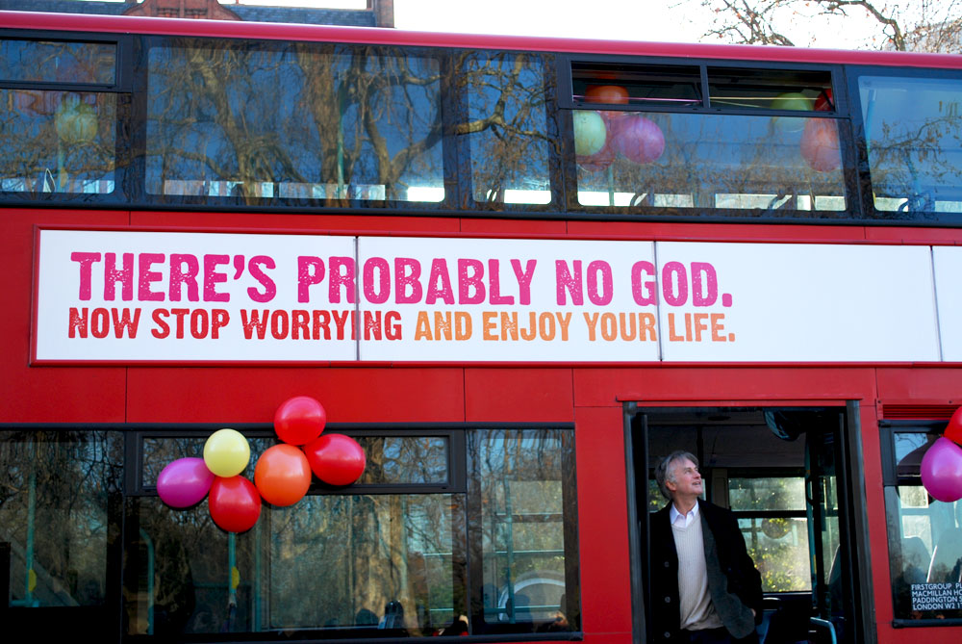

Slide 9
If you can’t handle being thought of as “a fool”,
you can’t handle being a Christian in Australia today
The word of the cross is folly to those who are perishing, but to us who are being saved, it is the power of God
Prominent academics become celebrities as they criticise Christianity
“It’s foolish to believe that God even exists”
But some who accept the existence of a god, reject the Gospel of Jesus Christ as folly
The foolishness of the cross. (that a god would die to save humans)
The weakness of Christians (ignorant; foolish; weak; inconsequential nobodies)
²⁶ For consider your calling, brothers: not many of you were wise according to worldly standards, not many were powerful, not many were of noble birth. ²⁷ But God chose what is foolish in the world to shame the wise; God chose what is weak in the world to shame the strong; ²⁸ God chose what is low and despised in the world, even things that are not, to bring to nothing things that are,

Slide 10
If you can’t handle being thought of as “a fool”,
you can’t handle being a Christian in Australia today
The word of the cross is folly to those who are perishing, but to us who are being saved, it is the power of God
Prominent academics become celebrities as they criticise Christianity
“It’s foolish to believe that God even exists”
But some who accept the existence of a god, reject the Gospel of Jesus Christ as folly
The foolishness of the cross. (that a god would die to save humans)
The weakness of Christians (ignorant; foolish; weak; inconsequential nobodies)
“Prove it to me with a sign, or convince me so that I will believe...”
We believe first... We experience the power of God... We have all the proof we need
Holy Spirit initiates belief & as we respond to the Spirit with faith, we experience Christ as the power and wisdom of God
The worlds ways and the worlds way of thinking (philosophy) infiltrates the church
“progressive Christianity” rejects the bible as childish fairytales for people who don’t know any better. “We are enlightened now”
Mostly shrinking; aging; dying
While churches who preach Christ crucified are young; vibrant; alive; growing

Slide 11
Tell me the old, old story, Of unseen things above, Of Jesus and His glory, Of Jesus and His love; Tell me the story simply, As to a little child, For I am weak and weary, And helpless and defiled.

Slide 12
Tell me the story slowly, That I may take it in— That wonderful redemption, God’s remedy for sin; Tell me the story often, For I forget so soon, The “early dew” of morning Has passed away at noon.

Slide 13
Tell me the story softly, With earnest tones and grave; Remember I’m the sinner Whom Jesus came to save; Tell me the story always, If you would really be, In any time of trouble, A comforter to me.

Slide 14
Tell me the same old story, When you have cause to fear That this world’s empty glory Is costing me too dear; And when the Lord’s bright glory Is dawning on my soul, Tell me the old, old story: “Christ Jesus makes thee whole.”

